Slide 1
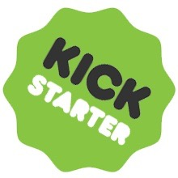
Raise Money on Kickstarter !
Annabel Wu
Chanel Wang
Casey Zhou

Slide 2
27 percent of businesses surveyed by the NSBA claimed that they weren’t able to receive the funding they needed.
82 percent of businesses that fail do so because of cash flow problems

Slide 3
Kickstarter
Kickstarter is a public-benefit corporation, which maintains a global crowdfunding platform focused on creativity and merchandising. Their mission is to "help bring creative projects to life".
2009
2010
2011-2017
2018
Launch
“Best Invention”
Development
Until Now
Kickstarter was launched on April 28, 2009, by Perry Chen, Yancey Strickler, and Charles Adler.
Time named it one of the "Best Inventions of 2010"
Gradually open projects based in United Kingdom, Canada, Australia, China, Japan, and Singapore
has reportedly received more than $4 billion in pledges from 15 million backers to fund 154,000 creative projects

Slide 4
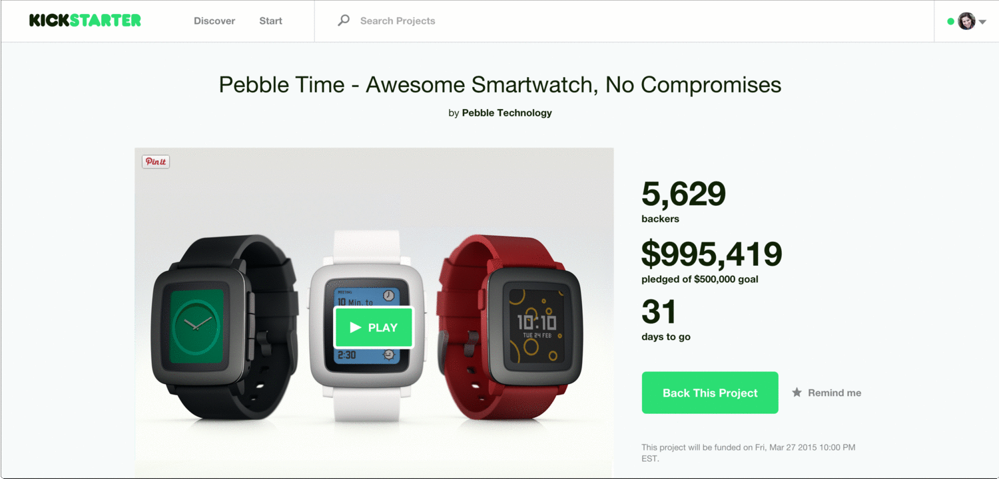
Kickstarter
Back Projects
Create Your Project

Slide 5
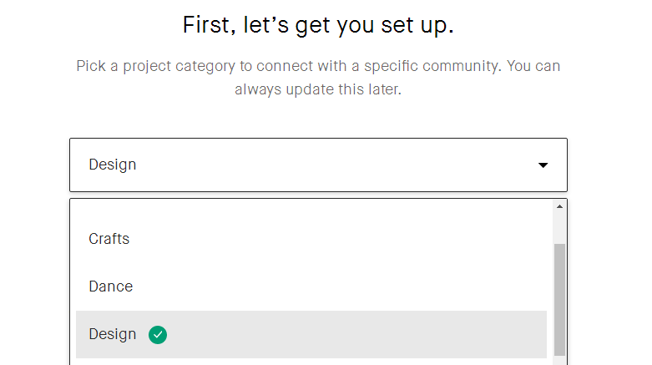
Kickstarter
Back Projects
Create Your Project

Slide 6
Business Problem Identification
Three problems are identified in sequence.
Problem 3
Problem 2
How to increase the money raised
Problem 1
Predict whether our project will succeed or not.
What factors on the kickstarter website presentation will influence the status of project.

Slide 7
Differentiation
How does our data mining projects differentiate from other projects?
Data attributes used (main): description, key words, disable communication, country
Data attributes used (main): goal, currency, category, deadline, state, country
Our
Project
Model: Text Mining, Logistic Regression
Model: Decision Tree
Sarchak
on
Github
Attributes: includes important presentation and interaction factors, including updates, awards, and comments.
Model: apply logistic regression, decision tree, and linear regression to get a synthetic prediction.
Ann Rajaram
on
Kaggle

Slide 8
Stakeholders
What stakeholders will our project benefit?
Fund
Raisers
Backers
&
Investors
Kickstarter
Help fund raisers to better design their project presentation on kickstater, increasing the probability to succeed.
Backers are seeking promising projects and investing in them.
If the projects succeed, they will get reward corresponding to the money they invested.
Time value of money！！！
If a project succeeds, kickstarter will charge for 3%-5% commissions.
Willing to increase successful projects.

Slide 9
Data Prepossessing & Exploratory Data Analysis
-Raw Data Screening
-Data Crawler
-EDA

Slide 10
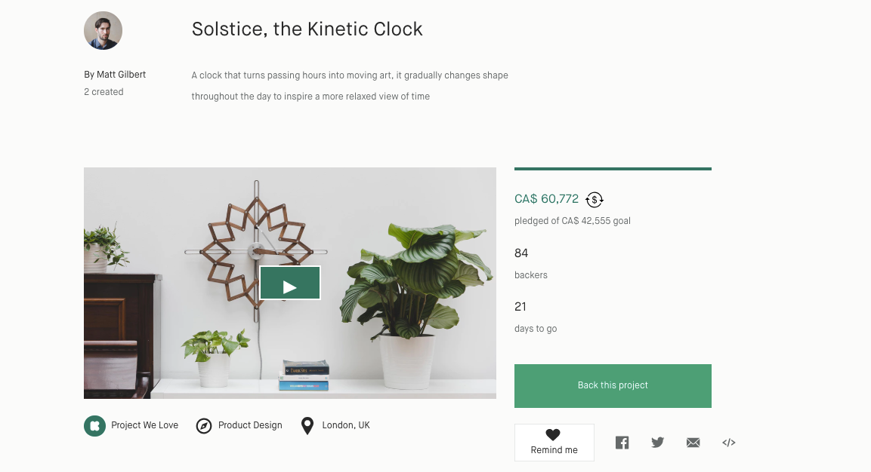

Slide 11
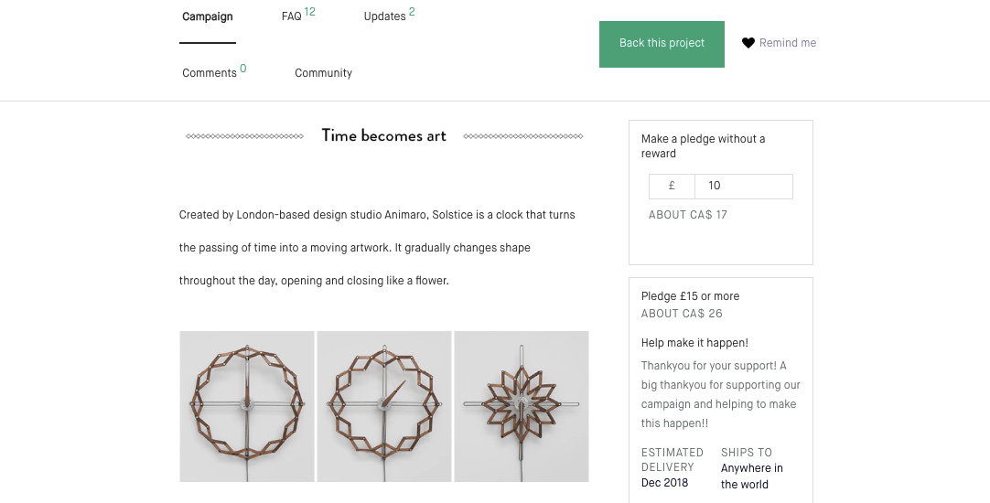

Slide 12
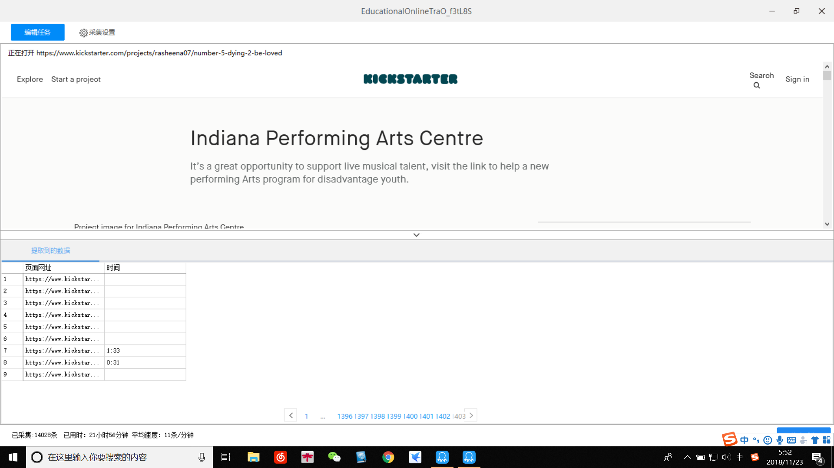
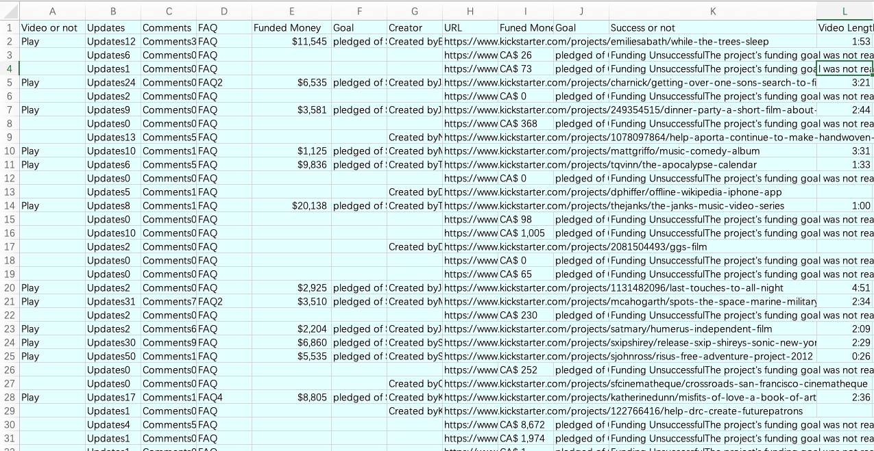
Using Data Crawler
- Add more attributes
- Cross-validate the raw data from Kaggle

Slide 13
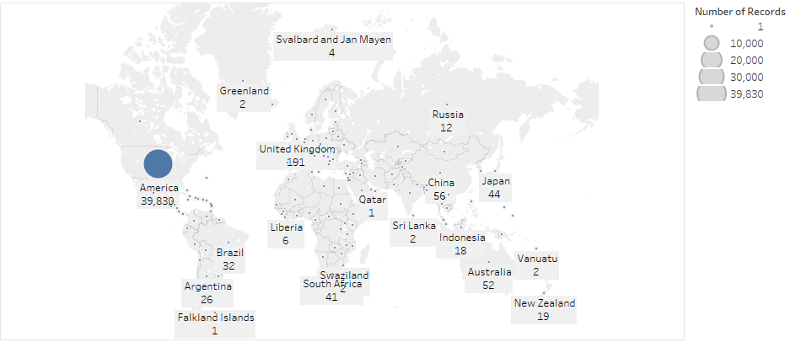
Kickstarter Projects Around the World

Slide 14
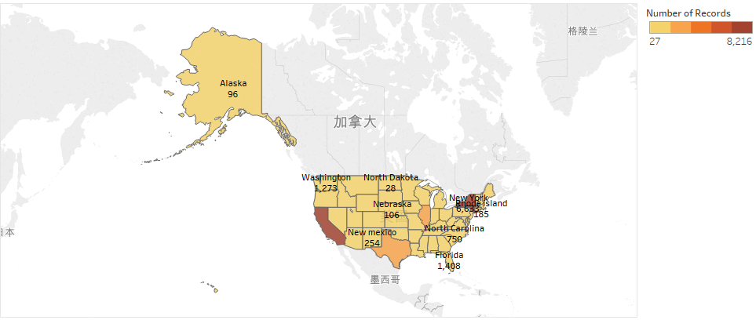
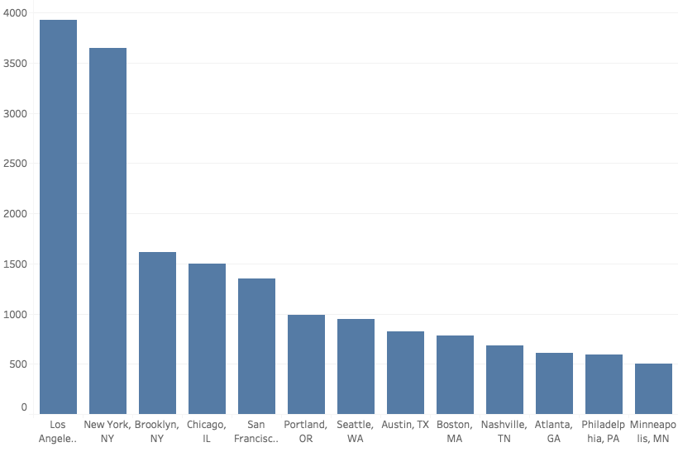
Kickstarter Projects in the US

Slide 15
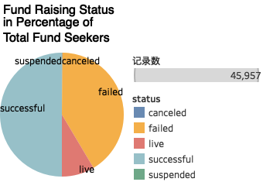
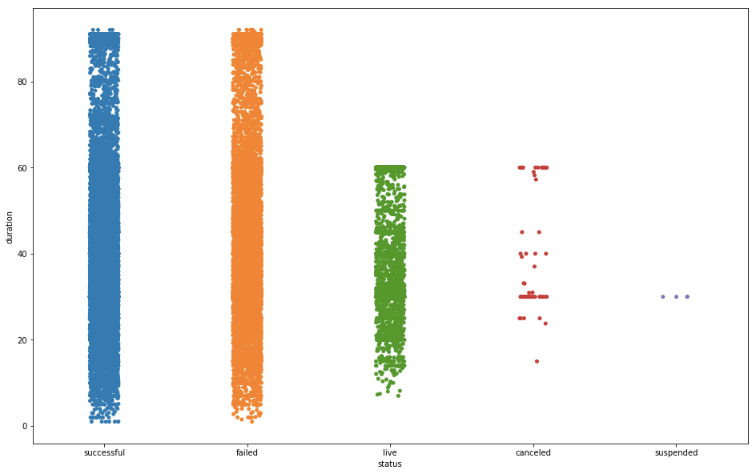
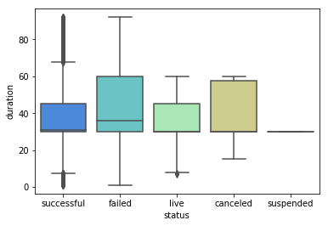
Fund Raising Status
Increase the project duration can not
increase the success rate

Slide 16
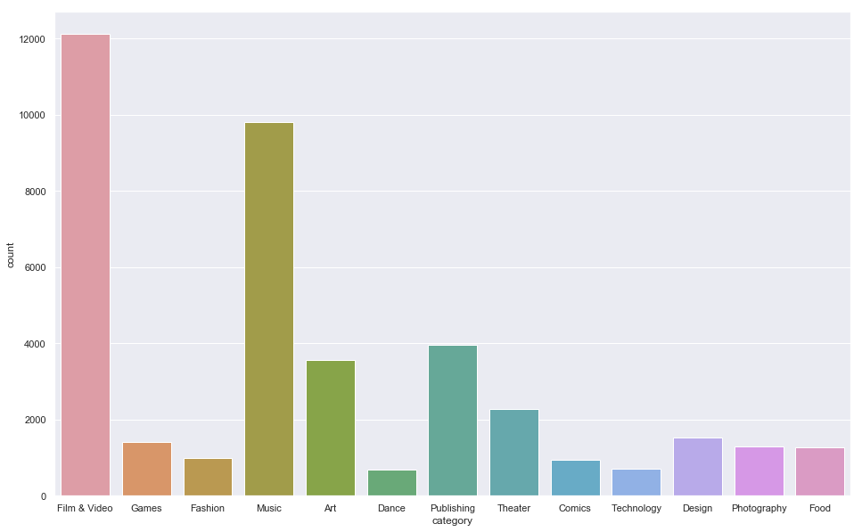
Fund Seekers Category-Wise

Slide 17
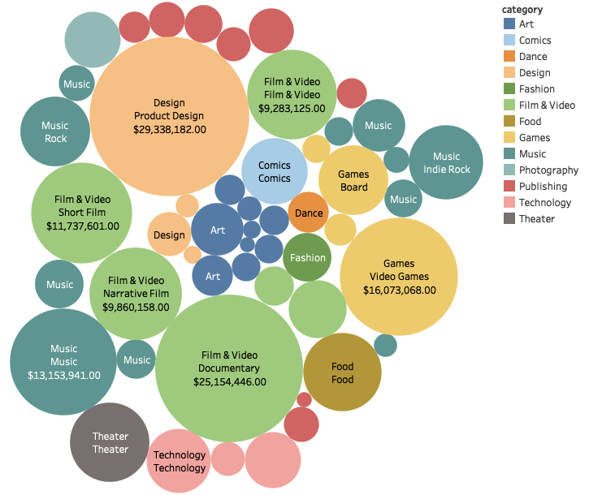
Total Fund Pledged Category/Subcategory-Wise

Slide 18
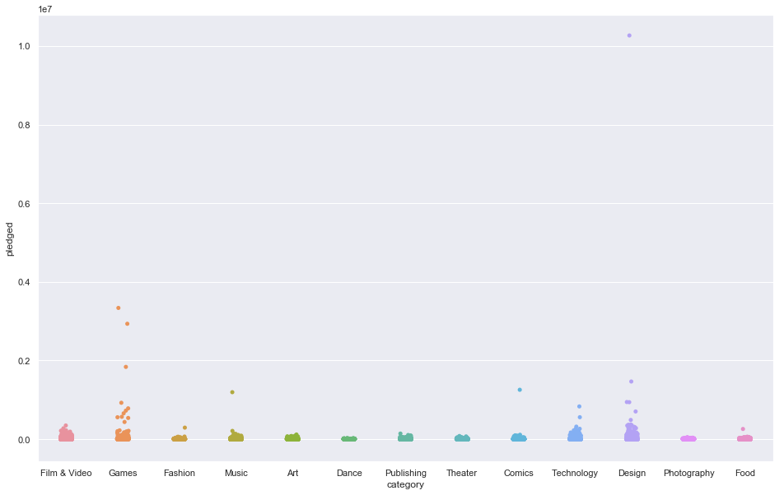
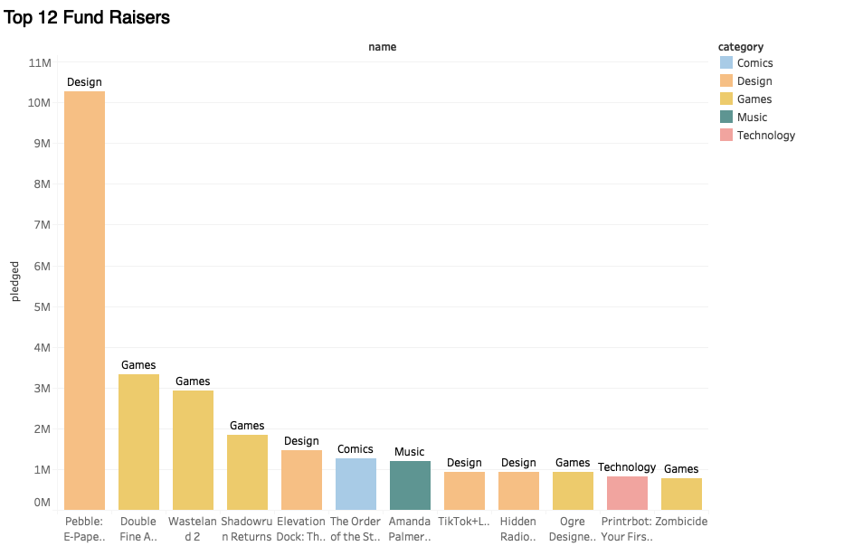
Total Fund Pledged Category-Wise & Top Fund Seekers
Design projects accumulate the most capital on Kickstarter

Slide 19
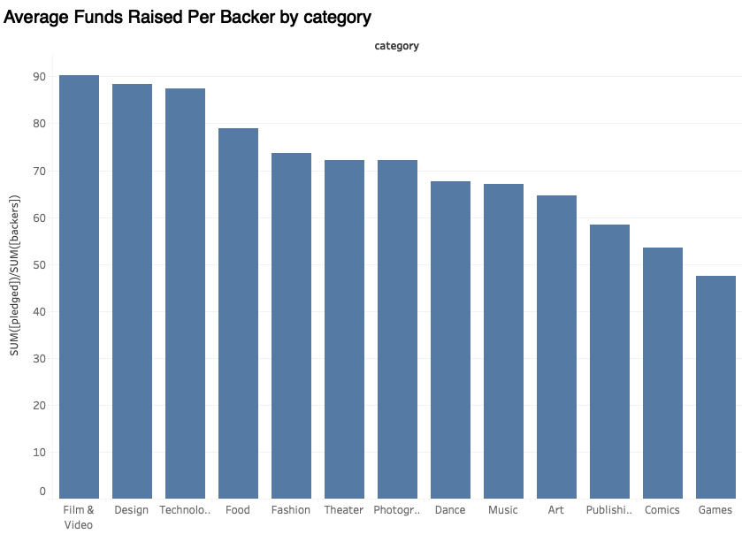
Average Fund Pledged Category-Wise

Slide 20
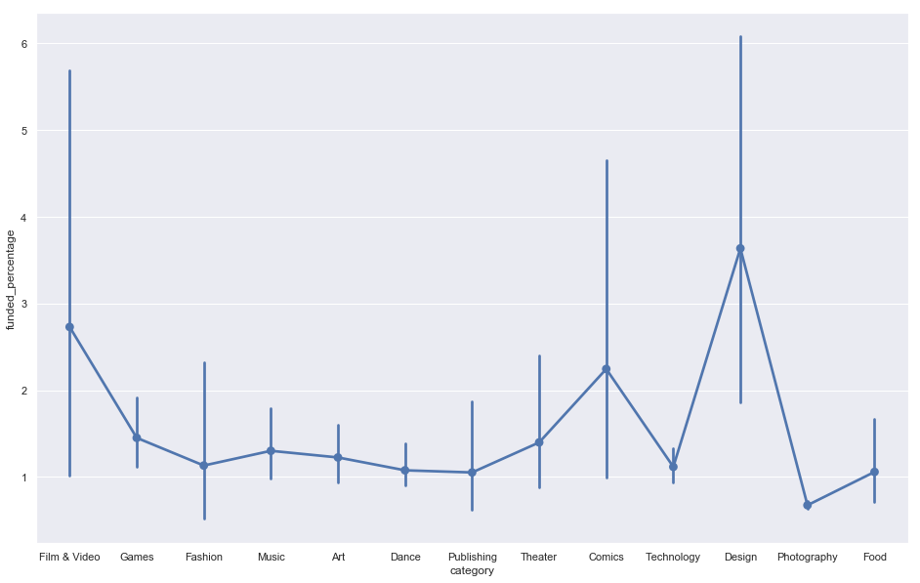
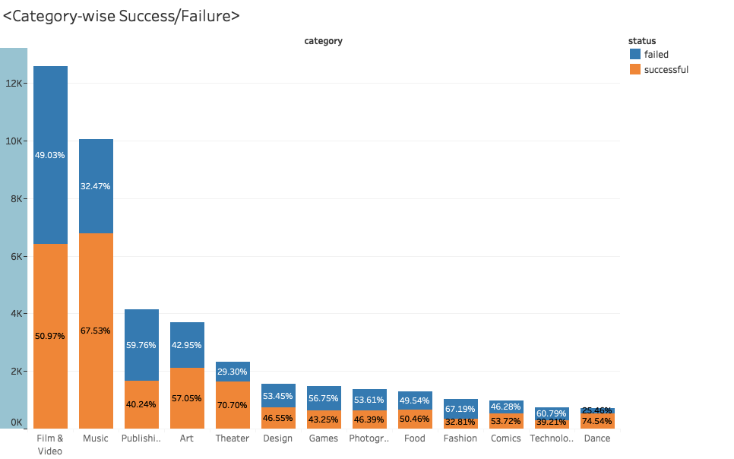
Funded Percentage / Success Rate Category-Wise

Slide 21
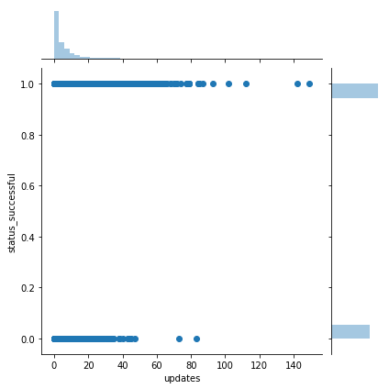
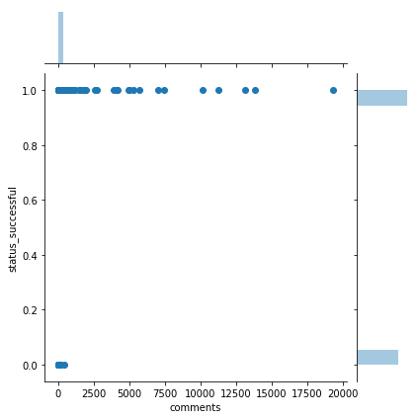
Relationship Between Updates / Comments and Success Status

Slide 22
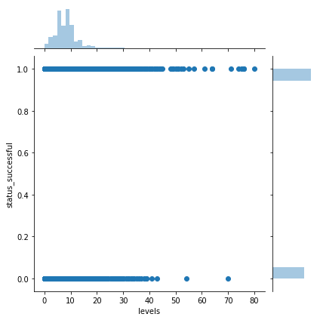
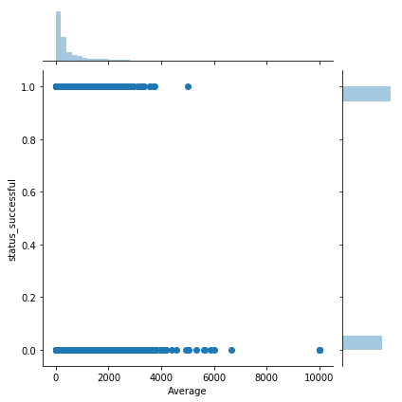
Relationship Between Reward Levels / Average Reward and Success Status

Slide 23
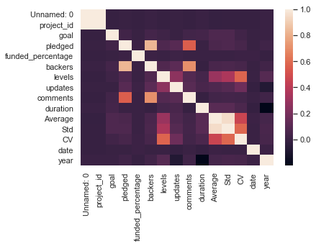
Correlation Heat Map

Slide 24
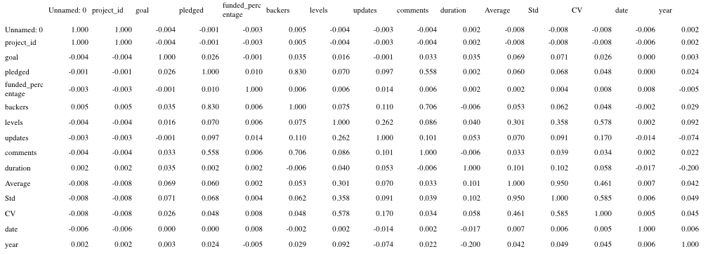
Correlation of Variables

Slide 25
Logistic Regression Model
-What factors on the kickstarter website presentation
will influence the status of project?

Slide 26
Logistic Regression
According to heat map and correlation between each two variables, delete factors highly correlated with other variables to build model.
Strong and medium correlation: > 40%

Slide 27
Logistic Regression
According to EDA, identify the factors to build model.
Updates
Levels of rewords
Comments
Averages

Slide 28
Logistic Regression
According to EDA, identify the factors to build model.
Category

Slide 29
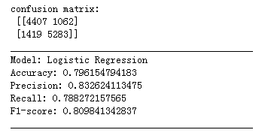
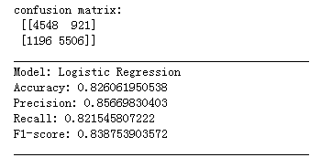
Logistic Regression
Test of model, add factors to increase accuracy continuously→results
Updates
Levels of rewords
Comments
Averages
Category
Updates
Levels of rewords
Comments
Averages
Category
Goal
Duration
Coefficient Variance
Date
Weekday
Month

Slide 30
Logistic Regression
Analyze the model.
 | Coef. | Std.Err. | z | P>|z| | [0.025 | 0.975]
goal | -0.0002 | 0.0000 | -43.7181 | 0.0000 | -0.0002 | -0.0002
updates | 0.3068 | 0.0062 | 49.8710 | 0.0000 | 0.2948 | 0.3189
Average | 0.0002 | 0.0000 | 3.2415 | 0.0012 | 0.0001 | 0.0003
levels | 0.0532 | 0.0061 | 8.7497 | 0.0000 | 0.0413 | 0.0651
comments | 0.2615 | 0.0070 | 37.3286 | 0.0000 | 0.2478 | 0.2752
duration | -0.0174 | 0.0010 | -17.8709 | 0.0000 | -0.0193 | -0.0155
CV | -0.1465 | 0.0494 | -2.9661 | 0.0030 | -0.2433 | -0.0497
category_Comics | -1.0305 | 0.1291 | -7.9835 | 0.0000 | -1.2834 | -0.7775
category_Dance | 1.0417 | 0.1259 | 8.2755 | 0.0000 | 0.7950 | 1.2884
category_Design | -1.0921 | 0.1134 | -9.6312 | 0.0000 | -1.3143 | -0.8699
category_Fashion | -1.0751 | 0.1175 | -9.1528 | 0.0000 | -1.3053 | -0.8449
category_Film & Video | 0.1480 | 0.0582 | 2.5415 | 0.0110 | 0.0339 | 0.2622
category_Food | -0.3028 | 0.1097 | -2.7606 | 0.0058 | -0.5178 | -0.0878
category_Games | -2.3994 | 0.1466 | -16.3717 | 0.0000 | -2.6866 | -2.1121
category_Music | 0.4085 | 0.0595 | 6.8676 | 0.0000 | 0.2919 | 0.5251
category_Photography | -0.5807 | 0.0996 | -5.8306 | 0.0000 | -0.7759 | -0.3855
category_Publishing | -0.7251 | 0.0720 | -10.0768 | 0.0000 | -0.8662 | -0.5841
category_Technology | -1.2878 | 0.1797 | -7.1668 | 0.0000 | -1.6399 | -0.9356
category_Theater | 1.0230 | 0.0818 | 12.5056 | 0.0000 | 0.8627 | 1.1833
 | P>|z|
month_Aug | 0.0065
month_Dec | 0.0101
month_Jul | 0.0002
month_Jun | 0.0197
……
Some significant dummies

Slide 31
Random Forest Model
-Predict whether our project will succeed or not?

Slide 32
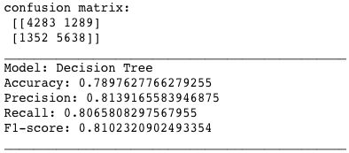
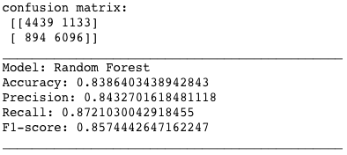
Random Forest with All Variables
Predictor Variables
Goal
Updates
Comments
Duration
Reward Levels
Reward - Average
Reward - Coefficient of Variation
Category (dummy)
Subcategory (dummy)
Date
Weekday (dummy)
Month (dummy)
Year
Location (dummy)
Importance
Updates
Goal
Comments
Reward - Average
Duration
Reward - Coefficient of Variation
Date
Reward Levels
Year
Location_New York, NY
Category_Theater
Category_Games
Category_Film & Video
Month_May

Slide 33
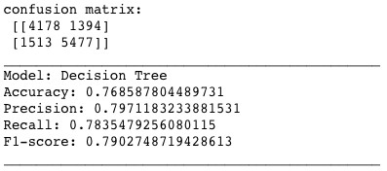
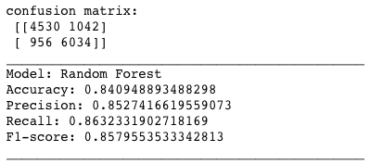
Random Forest with Selected Variables
Predictor Variables
Goal
Updates
Comments
Duration
Reward Levels
Reward - Average
Reward - Coefficient of Variation
Category (dummy)
Subcategory (dummy)
Date
Weekday (dummy)
Month (dummy)
Year
Location (dummy)
Importance
Updates
Goal
Comments
Reward - Average
Duration
Reward - Coefficient of Variation
Date
Reward Levels
Month_May
Category_Theater
Category_Music
Category_Games
Category_Film & Video
Category_Publishing

Slide 34
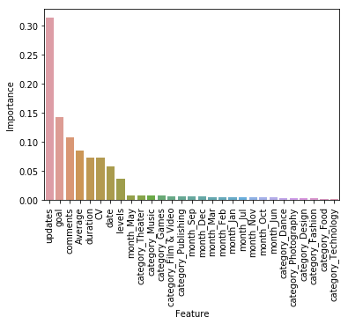
Importance of Variables
Top 3 Dimensions
Information transparency
and timeliness
Rationality of expectation
Interaction and
communication

Slide 35
A Prediction for Our Start-up Project
A
Name / Category
T Shirts for GSCLM (Design)
B
Goal
$ 300
C
Interaction
2 updates, 2 comments
D
Reward
5 levels: $5, $10, $15, $20, $25
E
Funding Time
November 22, 2018 — December 22, 2018

Slide 36
Simulation of Decision Tree Process
Updates
…
Goal
Comments
2
…
Reward
Average
2
…
$300
…
Duration
Reward
CV
3
…
15
…
Date
Reward
Levels
30
…
0.47
…
Month
22
…
Category
5
…
Nov
Success
Design
Failure

Slide 37
Simulation of Decision Tree Process
Updates
…
Goal
Comments
…
Reward
Average
Succeed!
2
2
…
$300
…
Duration
Reward
CV
3
…
15
…
Date
Reward
Levels
30
…
0.47
…
Month
22
…
Category
5
…
Nov
Success
Design
Failure

Slide 38
Linear Regression Model
-How to increase the money raised?

Slide 39
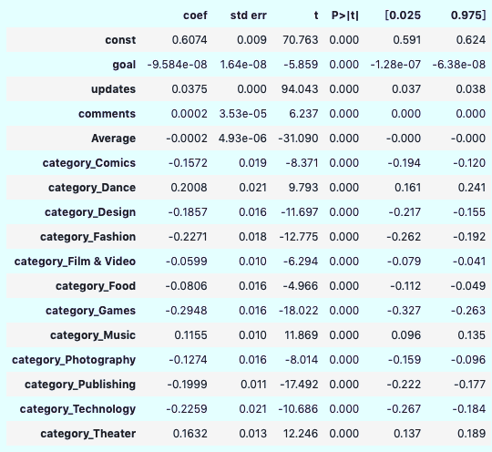
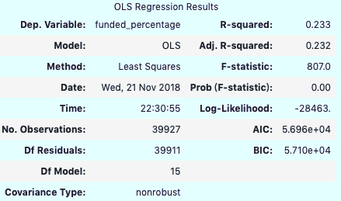
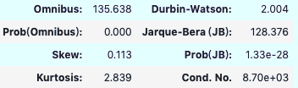
Linear Regression with Selected Variables（Feature Extraction)
Little Variation is explained
Predictor Variables
Backers
Updates
Comments
Updates
Reward Levels
Reward - Average
Goals
Category (dummy)
Skewness is large
Dependent Variable
Funded Percentage
Strong multicollinearity may exist

Slide 40
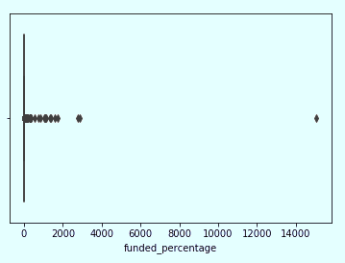
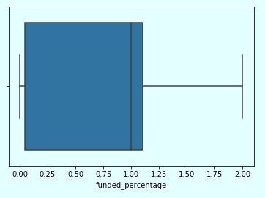
Evaluation of Linear Regression Model
Raw Data
After Scaling

Slide 41
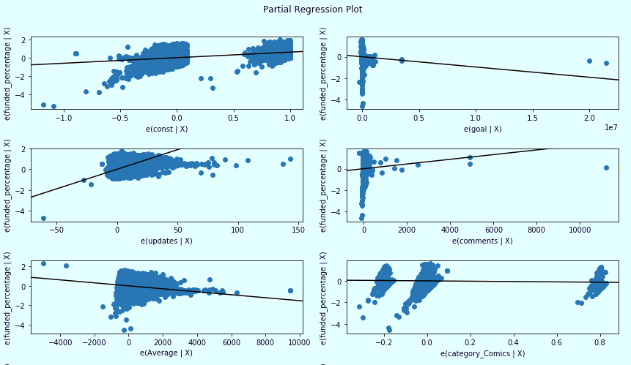
Evaluation of Linear Regression Model

Slide 42
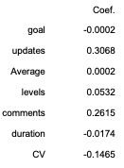
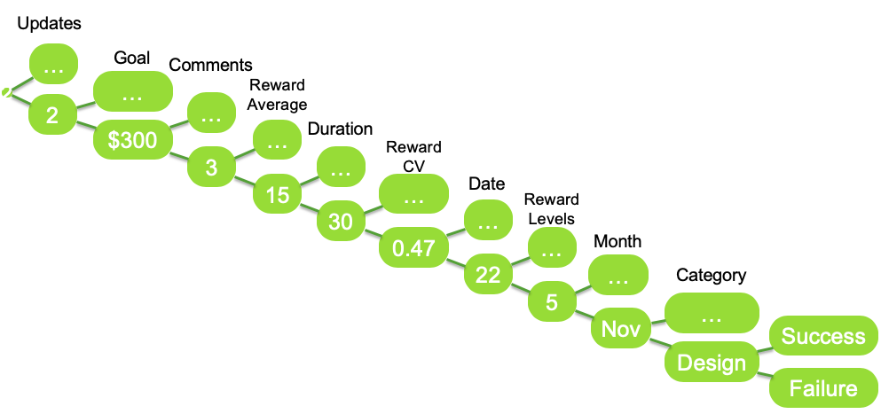
Recommendation
Suggestion 3
Suggestion 2
Little influence of your goal on your percent of funded
Focus on your project
Once reasonable, higher goal will not make your percent of funded less.
Suggestion 1
Using our RF prediction
Make a reasonable goal
Knowing your current stage
Interaction matters
- More updates
- Transparency and Communication
2. Awarding backers in level

Slide 43
Any Question?

